Slide 1
Web 3.0 Science
(Semantics & Knowledge)
Introduction
Dr. Saeedeh Shekarpour

Slide 2
History of Word Wide Web or (The Web)

Slide 3
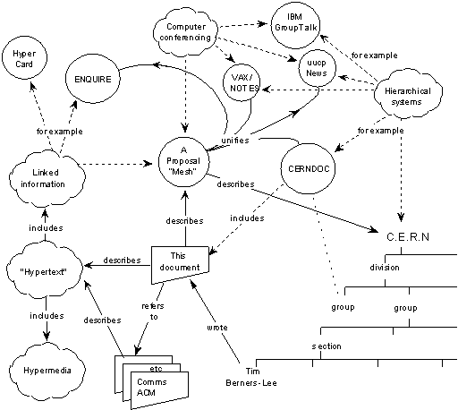
(1989) Web 1.0 (HTML, Hyperlink, Http )
The World Wide Web begins as a CERN (European Organization for Nuclear Research) project called ENQUIRE, initiated by British scientist Tim Berners-Lee. Other names considered for the project include “The Information Mesh” and “The Mine of Information.”
Reference: https://www.w3.org/History/1989/proposal.html

Slide 4

(1994) The Web consortium
To regulate the Web, Sir Tim Berners-Lee founded the World Wide Web Consortium. W3C gives technical support and guidelines that aims to maximise consensus about the web content and to ensure high standards.
https://www.w3.org/standards/

Slide 5
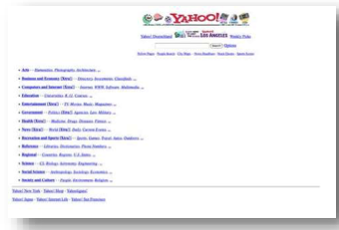
Yahoo (1994)

Slide 6
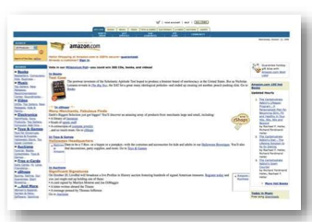
Amazon (1994)

Slide 7
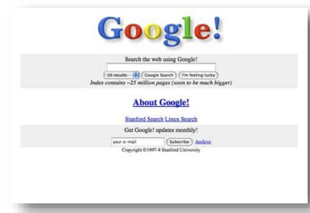
Google (1996)

Slide 8
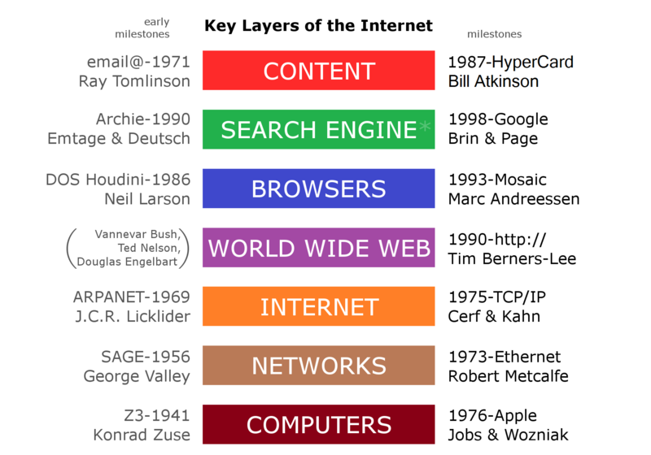
Key Layers of Web 1.0

Slide 9
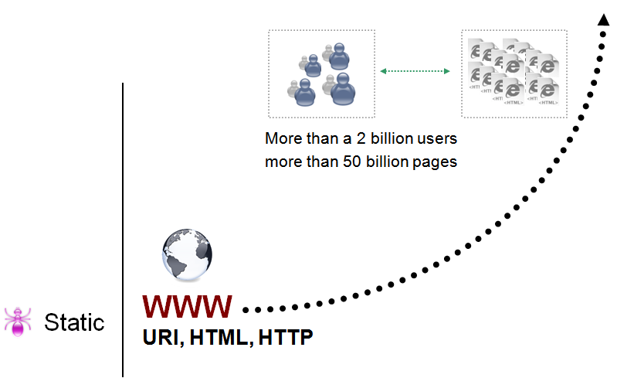
The Traditional Web

Slide 10
(1999) Web 2.0 (Social Web)
The web started to evolve from a broadcasting platform to an interactive media through use of blogs, applications and social media channels.

Slide 11
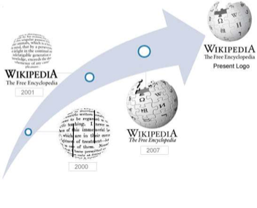
Wikipedia (2001)
One of the first websites that allowed people to have a more interactive relationship with the Web.
The free-access/free content Internet encyclopaedia is supported and hosted by the non-profit
Wikimedia Foundation.

Slide 12

Youtube (2005)

Slide 13

Twitter (2005)

Slide 14
Limitations of the current Web
Finding relevant information
Extracting relevant information
Combining and reusing information

Slide 15
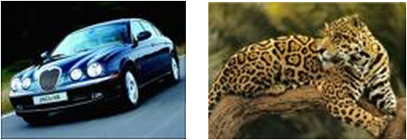
Finding relevant information
Finding information on the current Web is based on keyword search
Keyword search has a limited recall and precision due to:
Synonyms :
e.g. Searching information about “Cars” will ignore Web pages that contain the word “Automobiles” even though the information on these pages could be relevant
Homonyms:
e.g. Searching information about “Jaguar” will bring up pages containing information about both “Jaguar” (the car brand) and “Jaguar” (the animal) even though the user is interested only in one of them

Slide 16
Finding relevant information
Keyword search has a limited recall and precision due also to:
Spelling variants: e.g. “organize” in American English vs. “organise” in British English
Spelling mistakes
Multiple languages i.e. information about same topics in published on the Web on different languages (English, German, Italian,…)
Current search engines provide no means to specify the relation between a resource and a term
e.g. sell / buy

Slide 17
Extracting relevant information
One-fit-all automatic solution for extracting information from Web pages is not possible due to different formats, different syntaxes
Even from a single Web page is difficult to extract the relevant information

Slide 18
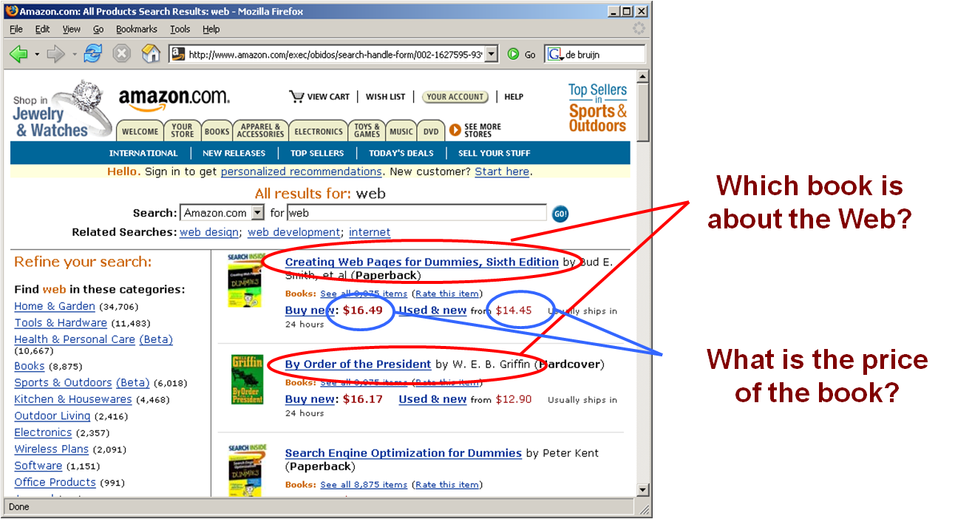
Extracting relevant information

Slide 19
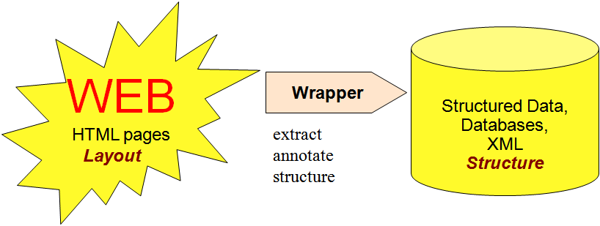
Extracting relevant information
Extracting information from current web sites can be done using wrappers
However, using wrappers do not really scale because the actual extraction of information depends again on the web site format and layout

Slide 20
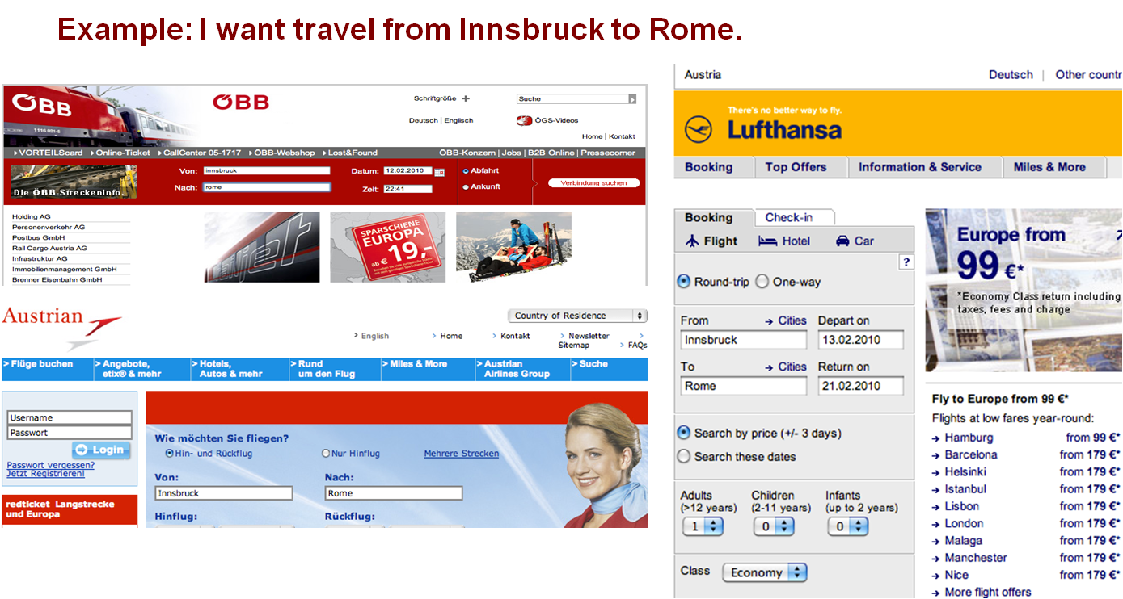
Combining and reusing information (Information Integration)
Tasks often require to combine data on the Web :Searching for the same information in different digital libraries

Slide 21
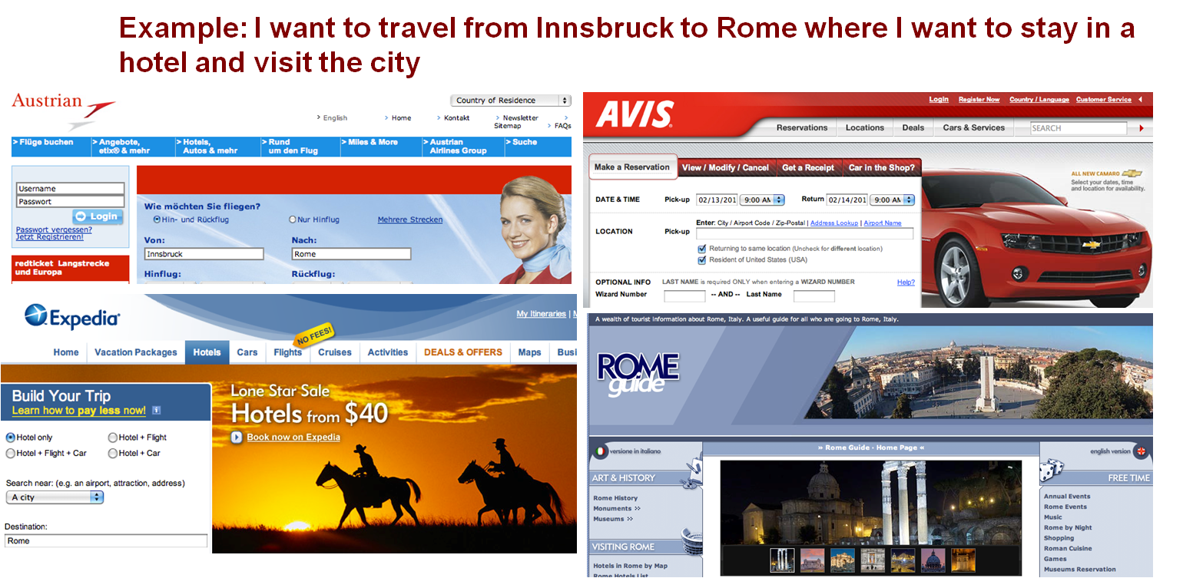
Information may come from different web sites and needs to be combined

Slide 22
How to improve the current Web?
Increasing automatic linking among data
Increasing recall and precision in search
Increasing automation in data integration
Increasing automation in the service life cycle
Adding semantics to data and services is the solution!

Slide 23
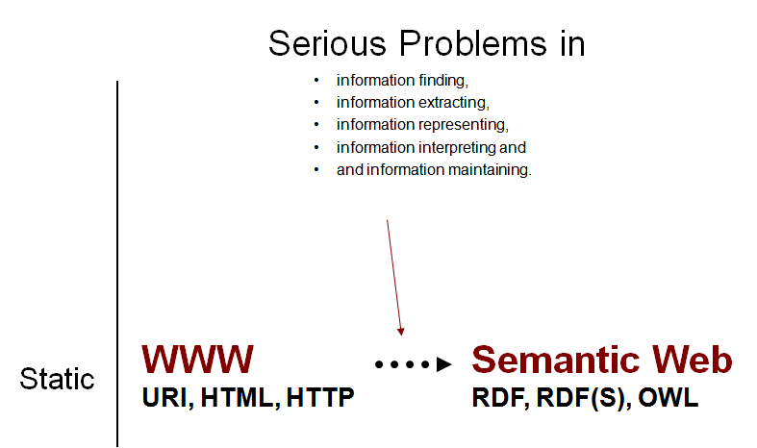
Semantic Web

Slide 24
Semantic Web
“An extension of the current Web in which information is given well-defined meaning, better enabling computers and people to work in cooperation.”
Tim Berners-Lee et al., Scientific American, 2001: tinyurl.com/i59p
“…allowing the Web to reach its full potential…”with far-reaching consequences
“The next generation of the Web”
The next generation of the WWW
Information has machine-processable and machine-understandable semantics
Not a separate Web but an augmentation of the current one

Slide 25
Semantic Web
Ontologies as basic building block
Web Data Annotation
connecting (syntactic) Web objects, like text chunks, images, … to their semantic notion (e.g., this image is about Innsbruck, Dieter Fensel is a professor)
Data Linking on the Web (Web of Data)
global networking of knowledge through URI, RDF, and SPARQL (e.g., connecting my calendar with my rss feeds, my pictures, ...)
Data Integration over the Web
Seamless integration of data based on different conceptual models (e.g., integrating data coming from my two favorite book sellers)

Slide 26
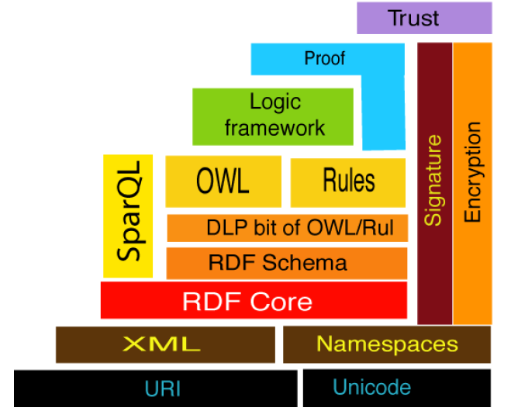
SW layer Cake

Slide 27
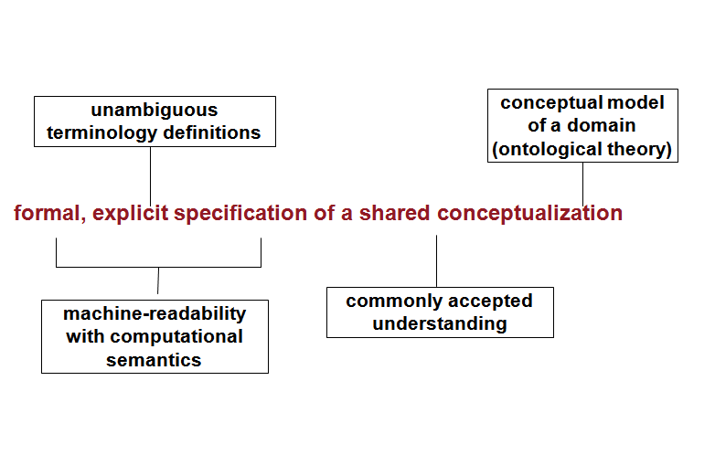
Semantic Web - Ontologies

Slide 28
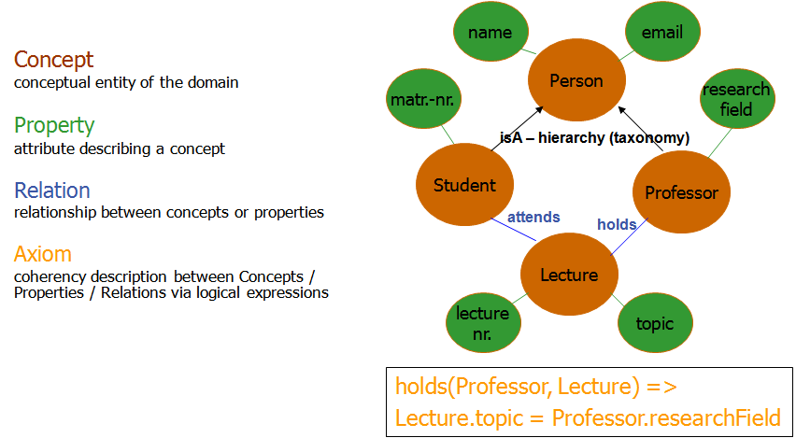
Components of Ontologies

Slide 29
Web of Data
There are more and more data on the Web
government data, health related data, general knowledge,
company information, flight information, restaurants,...
More and more applications rely on the availability of that data

Slide 30
Web of Data:
But... data are often in isolation, “silos”

Slide 31
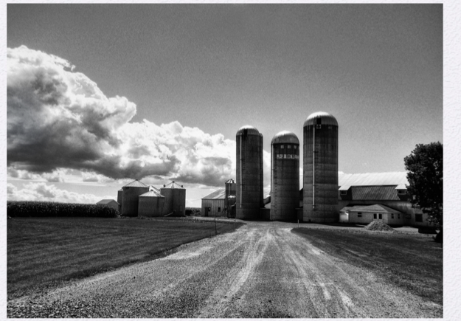

Slide 32
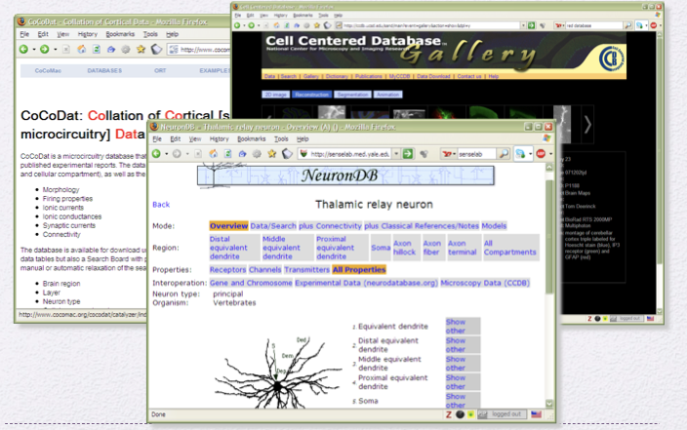
Imagine WWW with no hyperlink

Slide 33
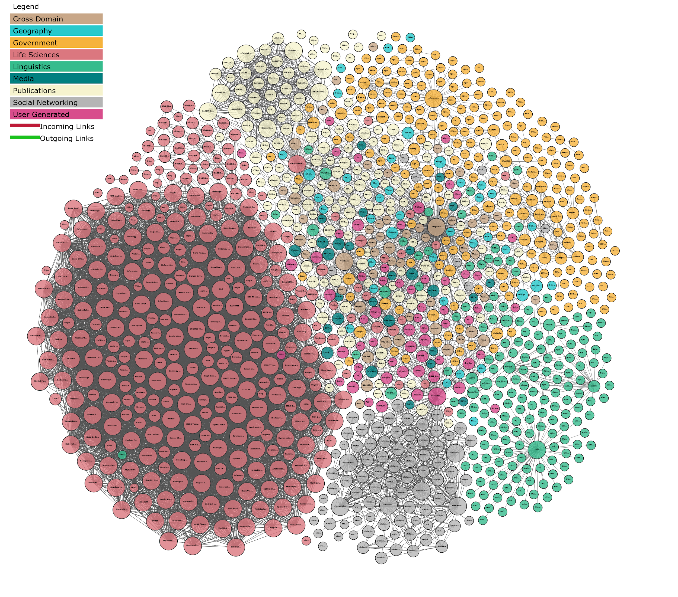
Web of Data (Linked Open Data Cloud)

Slide 34
Web Science
“Web science represents a pretty big next step in the evolution of information. This kind of research likely to have a lot of influence on the next generation of researchers, scientists and, most importantly, the next generation of entrepreneurs who will build new companies from this.”
Eric E. Schmidt, CEO Google
“Web science research is a prerequisite to designing and building the kinds of complex, human-oriented systems that we are after in services science.”
Irving Wladawsky-Berger, IBM

Slide 35
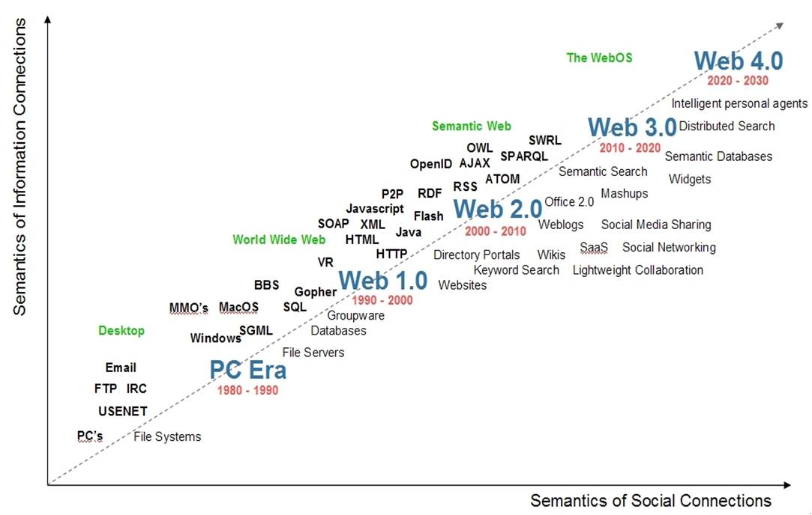
Evolution of the Web

Slide 36
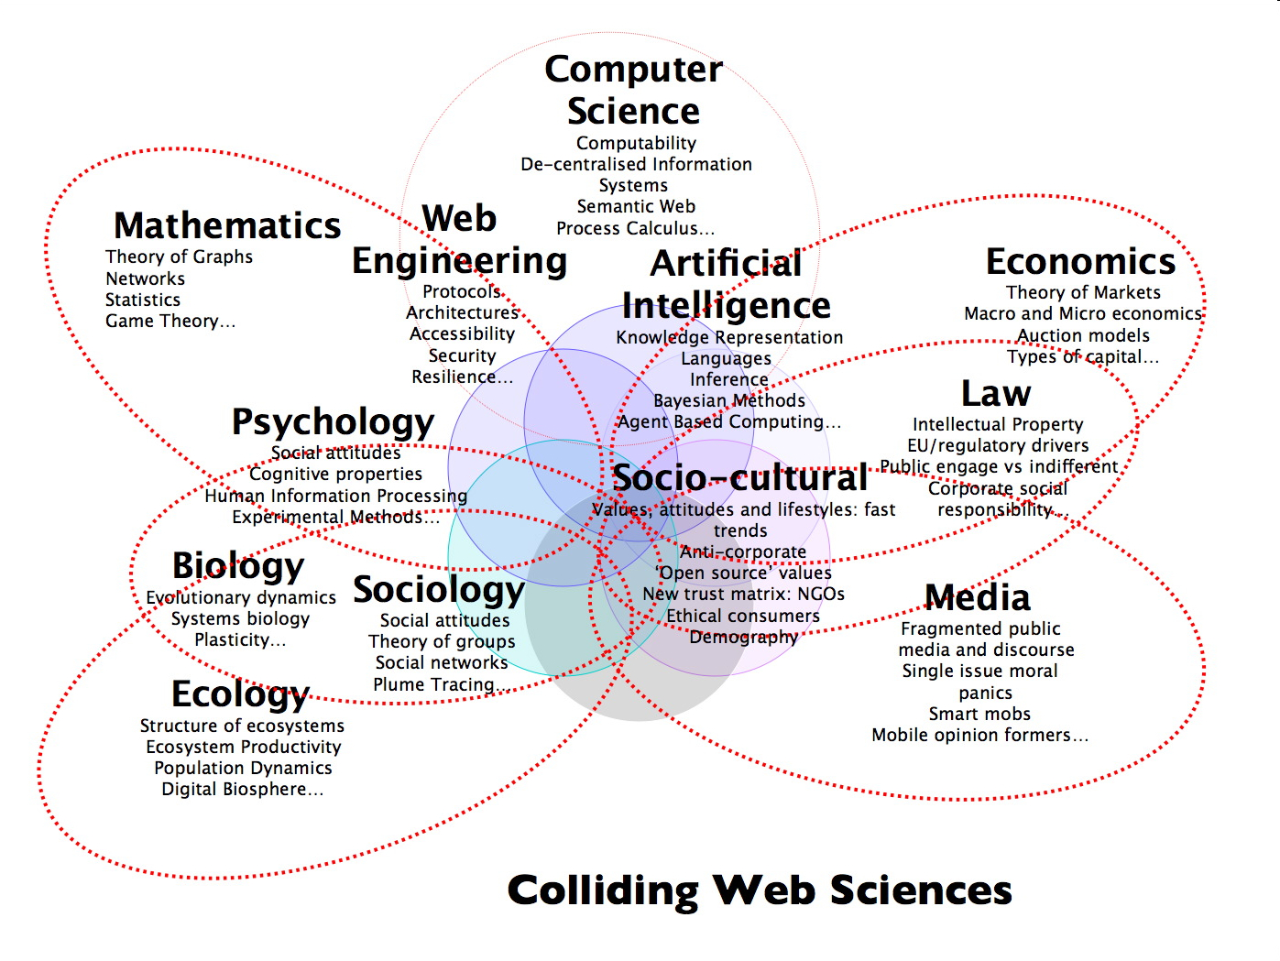
Web Science (multidisciplinary science)

Slide 37
The goals of Web Science
To understand the nature of the Web
To engineer the future of the Web and providing infrastructure
the Web’s social benefit and social good

